Slide 1
The MADLA planner: Multi-agent planning by combination of distributed and local heuristic search
20181023

Slide 2
Abstraction
Multi-agent planning aims at solving similar problems in the presence of multiple independent entities (agents). Even though such entities might want to cooperate in order to fulfill a common goal, they may want to keep their internal information and processes private. In such case, we talk about privacy-preserving multi- agent planning.
In this paper, we present the Multi-Agent Distributed and Local Asynchronous (MADLA) Planner, running a novel variant of a distributed state- space forward-chaining multi-heuristic search which combines the use of a local and a distributed heuristic in order to combine their benefits.
In particular, the planner uses two variants of the well known Fast-Forward heuristic.

Slide 3
Introduction
The recently most prevalent model for Multi-Agent Planning (MAP) goes back to the roots of research in planning itself—to STRIPS. The STRIPS model formalized planning by a propositional description of the world and the actions, together forming a transition system representing the planning problem. An extension of STRIPS towards MAP denoted as MA-STRIPS generalizes the model by allowing more than one finite set of actions, each characterizing capabilities of one agent. Since not all agents must necessarily be capable of influencing the whole environment, some parts of the information about it can be private to a single agent, alongside the common information public to all agents.
A distributed estimator for the FF heuristic, proven to return the same estimations as centralized FF, is MA-FF(based on building a distributed form of a Relaxed Planning Graph). MA-FF is, however, practically inefficient, more precisely, the results indicate that there is a trade-off between the quality of the heuristic estimation and the efficiency of its computation. This is similar to classical planning, where the computation of more informed heuristic is typically more time consuming. In multi-agent planning, the communication overhead of the distributed heuristic adds to the complexity of more informed heuristic and must be considered.

Slide 4
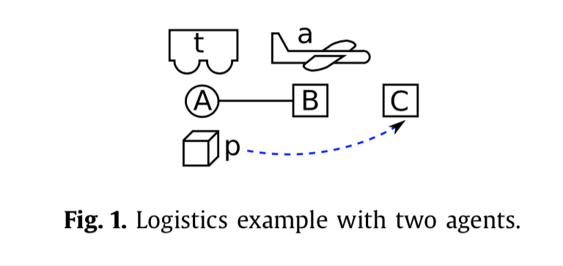
Introduction
The way to combine projected and distributed heuristic estimators in the multi-agent distributed state-space search resulting in an efficient planning approach, is an open problem. This is because the methods used in classical planning are clearly not suitable for this class of heuristics. As the main contribution of this article, we address this issue by designing a new search scheme, proving its soundness and completeness and evaluating it experimentally.

Slide 5
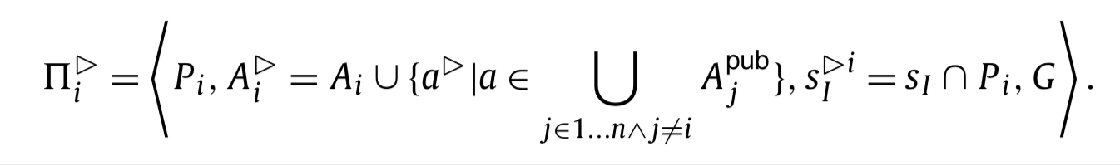
Introduction
Similarly to many other multi-agent planners, the MADLA planner starts with a classical PDDL input and a description of which PDDL objects are actually agents. After grounding the PDDL input to an internal representation of the global planning problem, it is partitioned to the agents and private and public parts are determined automatically, based on the properties of the problem and the MA-STRIPS definition.
We assume the quality criterion for a plan π to be its length |π|, that is a plan π is optimal iff it contains the minimal number of actions among all plans solving M.

Slide 6
MADLA Planner
The novel aspect of the search is that it is guided by a combination of two heuristics: h_{L}^{i} and h_{D}^{i} . The first heuristic h_{L}^{i} is a local projected heuristic, evaluating the single agent’s view (projection) of the problem, that is, 􏰀◃_{i} . The other one is a distributed heuristic h_{D}^{i} evaluating the multi-agent problem M in a distributed manner.
Although a distributed heuristic does not necessarily dominate a projected heuristic (or not in all states), dominance is a desirable property, because otherwise time is wasted on distributed computation without any benefit.
Informally, a heuristic function h1 is better informed than heuristic h2 for a search algorithm A if that search algorithm guided by h1 expands fewer states than the same algorithm guided by h2.

Slide 7
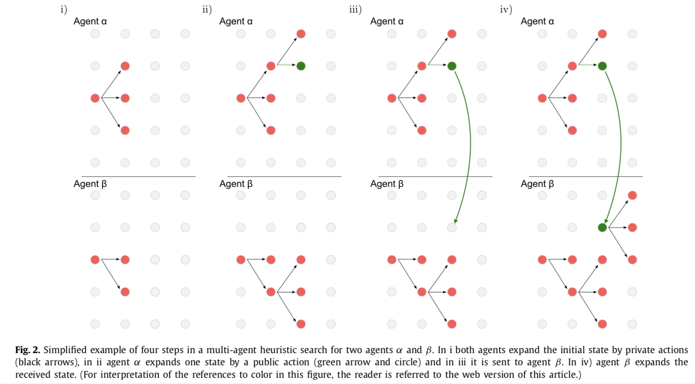
Search
We build on the idea of distributed state-space search and extend it to a distributed multi-heuristic search. We base the algorithm on the Greedy Best-First Search (GBFS) principle (the states are ordered solely according to the heuristic value) and also use the technique of deferred heuristic evaluation.
Multi-agent single-heuristic search
The main principle of multi-agent heuristic search is that all agents explore their portions of the search space asynchronously and in parallel, each agent using only its actions from Ai. In order to manage the coordination, states expanded using a public action are sent to all other agents. Thus the other agents are informed about the new reached state and can expand it.

Slide 8
MADLA Search
The main contribution of this paper is the MADLA Search, which is a variant of the multi-agent multi-heuristic search.
The main distinctive feature of the MADLA search is its use of two open lists per agent, where the first one is associated with a local projected heuristic and the second one with a distributed global heuristic. The main high-level principles of the search are the following:
a) Evaluate a state only using a single heuristic. b) Prefer the distributed heuristic, and only if the distributed heuristic is waiting for replies from other agents (i.e. is busy), use the projected heuristic instead.

Slide 9
MADLA Search
In the main search loop, after processing the communication (i.e. receiving and sending queued messages), a state is extracted from an open list. Which open list is used for the extraction is determined based on whether the distributed estimator of h_{D}^{i} is busy and the open lists are empty or not (as shown in Fig. 4). As we use deferred heuristic evaluation, the extracted state is evaluated by a heuristic (after it was checked for being in the closed list or being a solution), again depending on the state of the distributed heuristic estimator. If the extracted state was created using a public action, it is sent to all other agents. Then, the state is expanded using all applicable actions of the agent and its successors are added to the respective open list(s) as shown in Fig. 4 with the heuristic estimate of the parent state (again because of the deferred heuristic evaluation used).

Slide 10
Heuristics
The key principle behind the MADLA Planner is a favorable combination of both local (Definition 4) and distributed (Definition 3) heuristics. A heuristic pair complying with the search used in the MADLA Planner combines a light single- agent and a heavy distributed multi-agent heuristic which in this article are both forms of the classical Fast-Forward (FF) heuristic.
One of the most successful and most studied heuristics for satisficing planning is the FF heuristic. The FF heuristic belongs to the delete relaxation heuristic family. The idea behind delete relaxation heuristics is to simplify the problem by ignoring negative effects of actions.
Notice that thanks to the additivity of the relaxed problem, the relaxed plan can be represented as an unordered set of relaxed actions. From such set, the relaxed plan can be reconstructed by iteratively applying all actions as soon as they are applicable.
An optimal relaxed heuristic h+ is defined as the length of an optimal relaxed plan π+. In contrast to STRIPS planning, which is PSPACE-complete, finding an optimal relaxed plan π+ is NP-Complete [22], which is still impractical as a heuristic. In order to lower the complexity even more, approximations of h+ are used in classical planning. The most commonly used approximation in satisficing planning is to use the length of a sub-optimal relaxed plan (RP) instead of an optimal one. Finding a sub-optimal RP can have as low as polynomial complexity and therefore can be fast enough in practice.

Slide 11
FF Heuristic
The main idea behind the FF heuristic is to find a sub-optimal relaxed plan by analyzing which facts are successively reachable by applied relaxed actions (reachability analysis). From this analysis the relaxed plan is determined in a backward fashion. The principle is based on a notion of supporter action a of fact p which is an action a s.t. p ∈ add(a). Let 􏰀⁺ = 􏰄P , A⁺, sI , G􏰅 be a relaxed planning problem, then the principle of relaxed plan extraction is the following:
Initialize a set of unsupported facts U to contain all goal facts and a set of supported facts S to contain all initial state facts: U ← G, S ← sI .
Move an unsupported fact p from U to a set of supported facts S and determine its supporter a.
Mark all preconditions of a as unsupported if not supported already: U ← U ∪ (pre(a) \ S).
Loop 1–3 until all facts in U are supported: until U \ S = ∅.

Slide 12
Distributed Heuristic
A coordinated computation by multiple agents is necessary for evaluation of the distributed heuristic estimates. Computation of such a heuristic incurs a communication overhead, but the overhead is typically outweighed by heuristic estimates significantly better than the estimates of a projected heuristic.

Slide 13
Evaluation

Slide 14
Thank You

